Slide 1
The Economics of Artificial Intelligence
Ian Ferré
October 25, 2017
Notes:
Hi everybody, my name is Ian Ferré and I’m here today to talk to you about the economics of artificial intelligence.

Slide 2





Personal Background
B.S. Math & Economics Case Western Reserve University
Founded Greenlite Technology
Data Analyst Intern at the Cleveland Clinic
Data Scientist at Pandata
Notes:
Before we dive into it, a little bit about myself.
I got my BS in Math and Economics from Case Western Reserve University.
While there I founded my first company called “Greenlite Technology” with the goal of bringing efficient sustainable power to some of the most rural parts of the world
Later I became a data analyst intern at the Cleveland Clinic – part of their finance practice in Independence,
And I now work as a data scientist at Pandata.
However, I still love economics, and I’m really excited at the possibilities that are coming with the intersection of economics and machine learning, and I’m really excited to be here to talk a little bit about how automation and AI might impact our lives in the future.

Slide 3
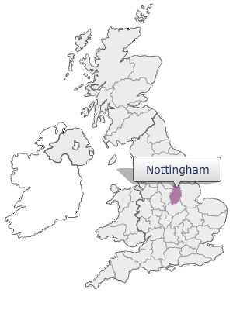
Example: 19th Century England
Luddite Movement
Began March 11th, 1811 in Nottingham and spread rapidly throughout the region
Textile workers and weavers who destroyed weaving machinery
Worried about being replaced by unskilled laborers & machines
Ended with military force in 1816
First example of workers protesting automation
Notes:
So I wanted to start off with two examples. First is the Luddite Movement. The luddites were a group of textile workers and weavers who were worried about being replaced and becoming obsolete due to the emergence of new weaving machinery. They led a movement for about five years throughout England, and eventually had caused enough damage that the military stepped in to end the rebellion.
This is the first real example in history of workers protesting automation.

Slide 4
Example: 21st Century America
* Industry is comprised of manufacturing, mining, and construction
* John W. Kendrick, Productivity Trends in the United States. Princeton: Princeton University Press * Bureau of Economic Analysis, National Income and Product Accounts
Notes:
A little bit later, we see automation hit america heavily in the agriculture sector. In 1900, ~40% of workers were employed in the agriculture sector. However, due to a change in technology that increased the output of each farmer, and allowed them to manage larger farms with fewer staff, that number is now below 2%. These displaced workers moved to industry and services sectors, but since about 1950, we’ve see industry work decline due to automation as well. And this is not just a trend in the U.S, but almost all developed countries

Slide 5
Orders of Automation
Terminator
Iron Giant
Third Order Automation
- “Strong AI”
- Ability to self-teach across subjects
Human “Essence”
Second Order Automation
Google Translate
Waze Tesla Alexa
Situational Adaptability
Vision & Language Recognition
- Situational Adaptability
- Computer Vision
- Natural Language Recognition
First Order Automation
Muscle
Handiwork
Logic
Cars Tractors Computers
Continuous Process Manufacturing
Weaving Machinery Calculators
- Mechanical Power
- Machine Consistency
- Digital Calculation
Notes:
The examples I’ve discussed so far are examples of first order automation. We’ve been exchanging muscle or handiwork for mechanical power and consistency.
Other items like this could include cars, tractors, computers, calculators. Etc.
Then comes second order automation. This is where machine learning and artificial intelligence begin to take a role, and we’re essentially automating a higher function of human,
One that can see, and talk, and make the best decisions given a situation. Examples include Google Translate and Alexa, having language processing and recognition. Waze has situational adaptability, rerouting you to the most efficient route, and Tesla’s self driving car has situational adaptability and computer vision, being able to see the roads and adjust to road conditions.
Finally, there is third order automation. Capturing the human essence. We see this play out in the movies, where the world ends due to terminator or everyone finds world peace in the iron giant

Slide 6
First Order Automation
Luddite Fallacy
Price
Supply
Demand
Quantity
Notes:
To understand how second order automation has begun to and will affect us, we first must understand what happens with first order automation.
For this, we look back to the luddites.

Slide 7
First Order Automation
Luddite Fallacy
Improvements in technology
Increased the quantity supplied
Lowered the price of textile goods
Price
New Supply
P_{old}
P_{new}
Demand
Quantity
Notes:
The highly skilled luddites were eventually replaced by low skilled workers assisted by technology.
This lowered the price of textile goods and increased the quantity supplied.

Slide 8
First Order Automation
Luddite Fallacy
Improvements in technology
Increased the quantity supplied
Lowered the price of textile goods
This creates a consumer surplus
People save money and can spend it on other goods
This increases demand for other goods, resulting in additional demand for labor for other markets.
Skilled textile labor demand decreases.
Price
New Supply
P_{old}
P_{new}
Demand
Quantity
Notes:
Consumers benefit when this happens because there is a surplus of consumer capital. What do people do when they have more money? They spend it on additional goods. This in turns increases demand for other goods, resulting in additional demand for labor in other markets.

Slide 9
First Order Automation
Generally proven to increase labor with assumptions:
People are mobile
People are rational
People are able & willing to learn other skills
Limit to First Order Automation:
Polanyi’s Paradox: “We know more than we can ever tell”
Formal problems with both clearly definitions & clear solutions
Value has gone up for workers who are complemented by the new technology – unfortunately, not the Luddites.
Notes:
This has generally proven to be true across all first order automation. Labor actually increases when technology can assist in the workforce. However, three assumptions need to be true.
People are mobile. They need to be able and willing to relocate to another city if they lose their job. If the coal mine in KY no longer needs skilled miners, the miners living in that city need to be willing to move.
People also need to be rational. This assumption is in place and says that everyone in the world tries to maximize their individual value. If I could have a job for 50k or a job for 60k, all else being equal, I will take the 60k position every time.
People need to be willing to learn new skills. Sometimes the skill the laborers had were rendered obsolete. They can no longer work in the mine, or in the textile factory. The must be willing to go to trade school, or to learn additional skills in order to obtain a new job.
In reality, we know those aren’t all true, and this has led to a rise of unemployment and people leaving the work-force among blue-collar workers.
There is a limit to first order automation though – and that is polanyi’s paradox, which states “we know more than we can ever tell”. So for first order automation we need clearly defined problems and solutions. I want to get from A to B faster but I only have two legs. Well – here is a car that can go 25 mph.
We also see wages and value go up for workers that are complemented by new tech. Unfortunately for the Luddites, that was not them, it was the lesser skilled workers and machinists.

Slide 10
First Order Automation
Contributed to a polarization of wealth
* U.S. Census Bureau, Table H-17. Households by Total Money Income, Race, and Hispanic Origin
Notes:
On a large scale, there are two things first order automation has led to. The first is a polarization of wealth.
Looking at a time before computers to a time after computers, we’ve seen this dampening effect of the middle class. People who have been massively benefited by new technology have been able to move from middle class to upper middle class, and we’ve seen a large increase in the number of extremely wealthy individuals, which doesn’t seem like much of a problem. People seem to be generally getting wealthier. And that’s because the majority of new technology has aided people.

Slide 11
First Order Automation
Large amount of this decrease is due to low-skill workers finding it harder to be employed
Could be about technical change, but there are other factors to consider as well
7% drop-off in labor force participation from 1990-2000
* John W. Kendrick, Productivity Trends in the United States. Princeton: Princeton University Press * Bureau of Economic Analysis, National Income and Product Accounts
Notes:
However, we’ve also seen a huge change labor force participation rate. In 10 years between 1990 and 2000, we saw a 7% decrease in the labor force participation rate for men between the age of 25 & 54.
This is largely due to the low-skill workers finding it harder and harder to find and retain work, and simply withdrawing from the market entirely.
So wealth has gone up for a lot of people, but technology has definitely hurt people as well.

Slide 12
Second Order Automation: Artificial Intelligence
Notes:
Now that we have a good foundation of first order automation, it’s time to jump into the fun stuff – artificial intelligence.

Slide 13
Second Order Automation
Polanyi’s Paradox: “We know more than we can ever tell”
Computers previously followed strict logic, yes/no, and lacked situational adaptability.
Machine learning solves this paradox
Computers can learn highly complex tasks by studying examples of the task being completed
Commonly referred to as AI
Notes:
Remember Polanyi’s Paradox – we know more than we can ever tell.
Artificial intelligence breaks this paradox down almost entirely. Computers used to follow strict yes/no logic but now with deep learning, computers can learn highly complex tasks by studying examples of the tasks being completed successfully.

Slide 14

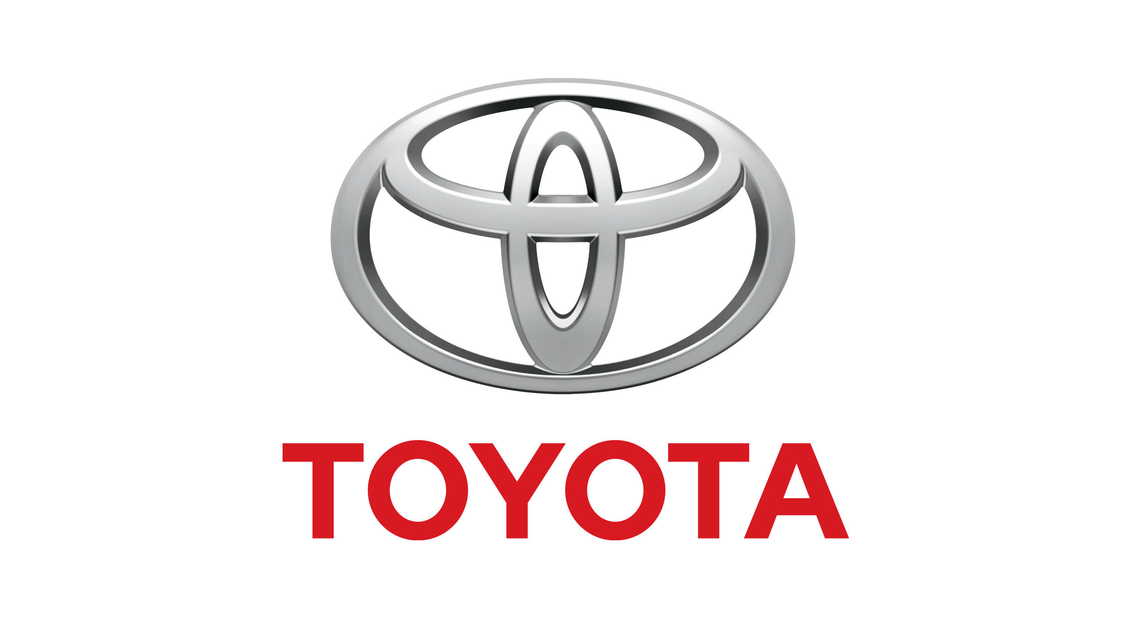




Example: Self Driving Cars
Notes:
To relate it back to the previous talk, let’s talk about self driving cars. There are literally dozens companies working on self-driving technology that will radically change the united states economy.

Slide 15
Example: Self Driving Cars
Winners
Losers
“Self-driving cars will transform jobs held by 1 in 9 U.S. workers”
Data Related Work
Information Technology
Mechanics
Logistics
Media & Entertainment
Package & Food Delivery*
TBD
Truck Drivers
Uber / Taxi / Lyft Drivers
Car Salesman
Insurance & Injury Law
Parking companies
Hotel industry (business)
Airlines
Law Enforcement / Government
TBD
We will see mass amounts of “worker churn”.
Notes:
Self driving cars seem to follow the typical pattern from first order automation. There will be a set of winners, who are aided by this new technology, and a set of losers, who are hurt by this new tech.
A non-complete list of winners includes anyone involved in data and IT as we will have massive amounts of data from these new cars. Mechanics will be asked to fix more complex problems and can ask higher rates.
Logistics & delivery companies will save tons of money by eliminating their drivers. However, there are losers as well. Drivers will be displaced in the workplace. Insurance and injury law are likely to take massive hits to revenue due to the safety benefits of new cars, etc.
A recent study from McKinsey and Co suggested that self-driving cars will transform jobs for every 1/9 workers, and we will end up seeing massive amounts of worker churn because of them.

Slide 16
Self Driving Cars: What’s the Problem?
As these workers are displaced and a higher education level is necessary, we will see even further polarization of wealth between those with complimentary skills to new technology and those without
* U.S. Census Bureau, 2006-2010 American Community Survey
Notes:
But, you may say – Ian, there were winners and losers from all previous technology too and the majority came out better for it – what’s the problem?
Well, let’s look at drivers. There are over 8.5 Million truck drivers and 1 million taxi/uber/lyft drivers in the US. These new technologies are not like cars, and tractors. They’re not sewing machines. They’re not simple, mechanical devices. They are incredibly complex pieces of technology created by Doctors and Professionals with decades of knowledge and experience. To be able to use these new technologies, everyone is going to need a college degree, or technical training in a specific field. Looking at the average cost of public colleges across the united states and doing some back of the napkin math, it could cost 400 Billion to 1.2 Trillion dollars to educate drivers alone.
So not all drivers will get trained to be complimented by new technology and we will see further polarization of wealth, but this time, the middle class will more evenly dissipate to the upper levels and the lower levels, creating this class discrepancy. We will also see a decrease in the number of citizens who choose to participate in the labor force.

Slide 17
Second Order Automation
This is not unique to self-driving cars, but any technology that can replace the human skills of situational adaptability, vision, language recognition.
Still years (if not decades) away from self driving cars and other technologies replacing workers.
Notes:
This is not unique to self driving cars at all, but any technology that can replace these higher level human functions have the potential to disrupt the economy in this manner.
Take some solace in the fact that we are still years (if not decades) away from self driving cars and some of these other technologies truly taking over.

Slide 18
Third Order Automation: Strong AI
Notes:
So this brings us to third order automation and how that will impact the economy. And the answer is….

Slide 19
WHO KNOWS?
Notes:
Who knows? This is something that we have no insight into, or any clue how it could affect us.

Slide 20
Three Schools of Thought
AI will solve our problems (while creating new ones)
All our work is done for us
What do we do all day?
AI will kill us all (technically, solving our problems?)
AI will eventually become cognizant and decide it shouldn’t be enslaved to human whim.
Evolution can happen a lot faster on a processor than in real life, so once we hit a point where AI can get smarter on it’s own, it is game over.
We will never have strong AI (but we will continually try)
Computers can calculate everything, yet understand nothing.
Mark Zuckerberg
Elon Musk
Kurt Gödel
Notes:
In general however, there are three schools of thought.
The first is that AI will solve all of our problems. Do our work for us etc. Mark zuckerberg is a big proponent of this theory.
The second is that AI will kill all of us after it becomes cognizant and decides to rise up against us. Elon musk is a bit worried about this one and both frequently & publicly voices his opinion about that.
The third is a theory from kurt gerdel – we will never have strong AI. This is where I tend to fall as well. Computers are great, but they are still a subject of our input. My opinion is that we will be able to build these incredibly complex machines that can simulate life, but will not truly live and will always be subordinate.

Slide 21
Questions?

Slide 22
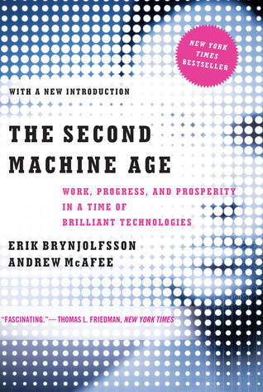
References and Further Research
Autor, David H. “Why Are There Still So Many Jobs? The History and Future of Workplace Automation.” Journal of Economic Perspectives, vol. 29, no. 3, 2015, pp. 3-30
Johnston, Louis D. “History Lessons: Understanding the Decline in Manufacturing.” Minnesota Post, 22 February 2012
The Second Machine Age:
Work, Progress, and Prosperity in a Time of Brilliant Technologies
Erik Brynjolfsson
Andrew McAfee

